Slide 1
Emerging SUAS Technology for Precision Agriculture Applications (AGDRONETECH14)
YangQuan Chen, Ph.D., Director,
MESA (Mechatronics, Embedded Systems and Automation)Lab
MEAM/EECS, School of Engineering,
University of California, Merced
E: yqchen@ieee.org; or, yangquan.chen@ucmerced.edu
T: (209)228-4672; O: SE1-254; Lab: CAS Eng 820 (T: 228-4398)
May 27, 2014. Tuesday 8:40-12:40 PM @ Wyndham Grand Orlando Resort,
Pre-conference Tutorial #1 of ICUAS 2014.
Emerging SUAS Technology for Precision Agriculture Applications (AGDRONETECH14), Orlando, FL, USA

Slide 2
Agenda
Time | Topic | Presenter | Remarks
08:00am-08:45am | Introduction to each other | Everyone | Dropbox sharing
08:45am-09:00am | Introduction to tutorial | YangQuan Chen | Tutorial schedule
09:00am- 09:30am | The Data Drone Age and Privacy and Insurance | YangQuan Chen | UAV based personal remote sensing (PRS)
09:30am- 09:55am | THE FAA COA Process | Brandon Stark
09:55am-10:15am | Coffee break/networking,
10:15am-11:00am | UAV applications in precision ag: benefits and the future potentials | Reza Ehsani
11:00am-11:30am | Remote Sensing and Vegetation Indices for UAS | Brandon Stark
11:30am-12:00am | Optimal UAV crop dusting as a cyber physical system | YangQuan Chen
12:00pm-12:45pm | Round table discussions, moderated by YangQuan Chen

Slide 3
Welcome! Together, we are making history – “Personal Remote Sensing” or Wright Brothers 2.0

Slide 4
An Analogy – Why go “Personal”?
1970s: Personal Computer (PC) – Bill Gates
2010s: Personal Remote Sensing (PRS) - ????
Low cost, affordable. Robust, easy to use
Run way free; Autonomous/cognitive
Swarm/coven;
Enabling new apps and services
Google 4D map (x,y,z,t) paid service
Ubiquitous remote sensing (Twitter as sensors …)
…

Slide 5
Let us get to know each other a bit
Your name?
From where and which institution?
Research interests?
Why sitting here and what you expect from this tutorial?

Slide 6
Outline of Tutorial Introduction
About MESA @ UC Merced
ICUAS2011
ICUAS2012
ICUAS2013
Towards “The Drone Age”
IEEE RAS TC ARUAV

Slide 7
Skip Ad in 1 minutes

Slide 8
UC Merced
The Research University of the Central Valley
Centrally Located
Sacramento – 2 hrs
San Fran. – 2 hrs
Yosemite – 1.5 hrs
LA – 4 hrs
Surrounded by farmlands and sparsely populated areas

Slide 9
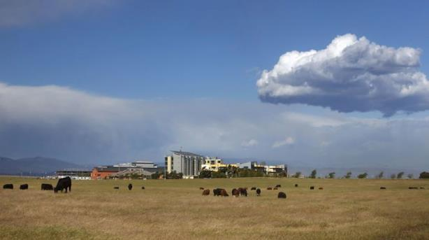
UC Merced
Established 2005
1st research university in 21st century in USA.
6,200 Undergraduates
300 Grads (200+ Ph.D)
Strong Undergraduate Research Presence (HSI, MSI)

Slide 10
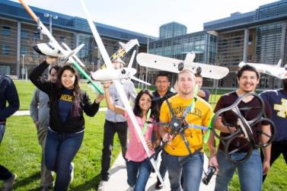
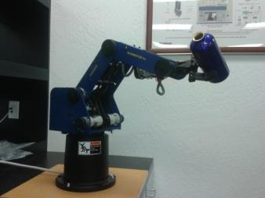
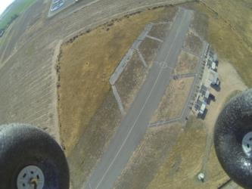
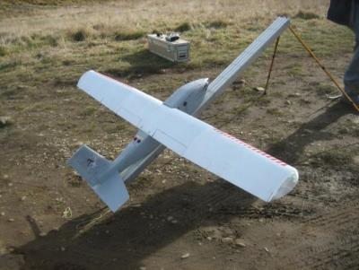
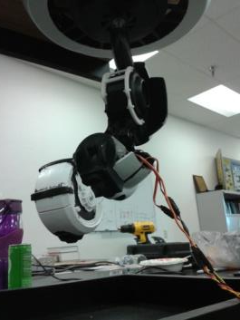
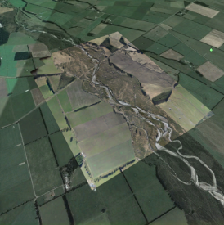
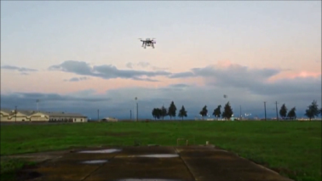
The MESA Lab
Mechatronics, Embedded Systems, Automation Lab
http://mechatronics.ucmerced.edu
Lab Director: Prof. YangQuan Chen
Lab Manager: Brandon Stark
5 Ph.D. Students
1 MSc Student
20+ Undergrads
3 Visiting Ph.D. Students
7 Visiting Professors/Scholars
Unmanned Aerial Systems
Cyber-Physical Systems
Renewable Energy Systems
Mechatronic Systems
Applied Fractional Calculus

Slide 11
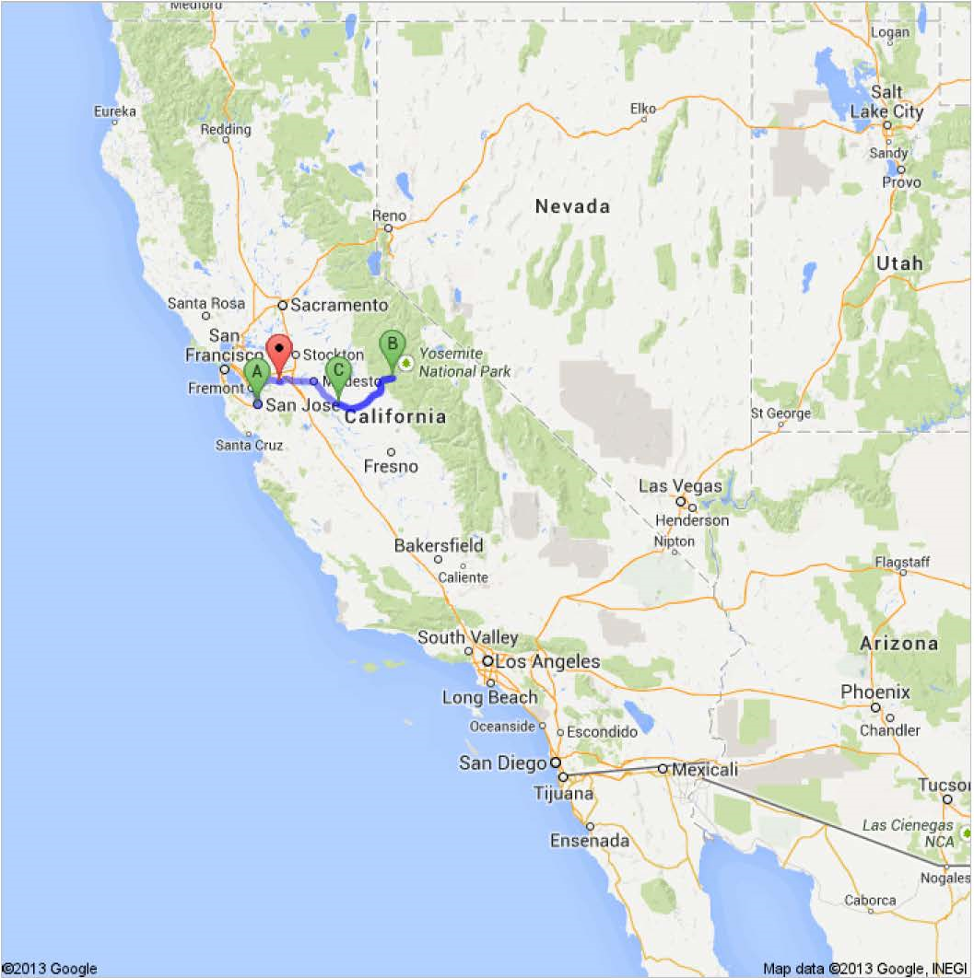
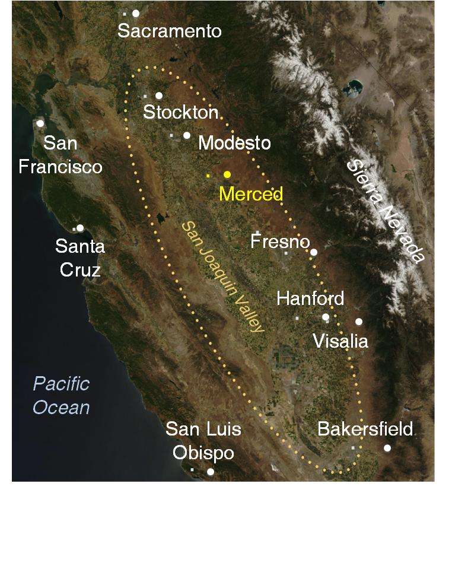
Data Drone Valley

Slide 12
MESA Research Areas/Strengths
Unmanned Aerial Systems and UAV-based Personal Remote Sensing (PRS)
Cyber-Physical Systems (CPS)
Modeling and Control of Renewable Energy Systems
Mechatronics
Applied Fractional Calculus (AFC)

Slide 13
ICUAS’11 (Denver): “Multi-UAV based multi-spectrum collaborative personal remote sensing - concept, platform, and applications”

Slide 14
Tutorial Schedule
Time | Topic | Presenter | Remarks
8:30am-9:00am | Introduction to each other | Everyone | Dropbox material downloading or USB file sharing
9:00am-9:15am | Introduction to tutorial | Dr Chen | Tutorial schedule
9:15am- 10:15am | Introduction to CSOIS, UAS research programs | Dr Chen | UAV based remote sensing as part of Cyber Physical Systems (CPS)
10:15am-10:30am | Coffee break |  | Provided
10:30am-11:15am | Introduction to AggieAir | Austin | With live demos
11:15am-12:00pm | Representative PRS applications using Aggie Air | Austin | Videos & PRS end product Mosaics
12:00pm-1:00pm | Lunch break |  | On your own

Slide 15
1:00pm-1:45pm | OSAM (open source autonomous miniature/multiple) architecture: fundamentals | Dee | History, basic knowledge, Paparazzi,
1:45pm-2:30pm | OSAM (open source autonomous miniature/multiple) architecture: intermediate | Dee | Single UAV, Platforms
2:30pm-3:15pm | OSAM (open source autonomous miniature/multiple) architecture: advanced | Dee | MUAVs, IMUs
3:15pm-3:30pm | Coffee break |  | Provided
3:30pm-4:15pm | Best practice in pre-flight and flight test protocols | Austin
4:15pm-5:00pm | Airworthiness, FAA regulations | Austin
5:00pm-6:00pm | Roundtable discussions and mind-storming on the future of low-cost UAV based PRS | Everyone | Bonus session

Slide 16
ICUAS’12 (Philladelphia): “Low-cost UAV-based precision thermal infrared (TIR) mapping - A new Personal Remote Sensing capability: UAV platform, TIR payload, in-flight calibration and applications.”

Slide 17
Tutorial Schedule
Time | Topic | Presenter | Remarks
8:30am-9:00am | Introduction to each other | Everyone | Dropbox material downloading or USB file sharing
9:00am-9:15am | Introduction to tutorial | Dr Chen | Tutorial schedule
9:15am- 9:30am | Introduction to CSOIS, UAS research programs | Dr Chen | UAV based personal remote sensing (PRS)
9:30am- 10:15am | Cyber-physical systems enabled by UAV-based PRS | Cal Coopmans | Applications scenarios of CPS with UAVs
10:15am-10:30am | Coffee break |  | Provided
10:30am-11:15am | Introduction to AggieAir | Austin Jensen | With video clips
11:15am-12:00pm | Representative PRS applications using Aggie Air | Austin Jensen | videos and PRS end-product mosaics
12:00pm-1:00pm | Lunch break |  | On your own

Slide 18
1:00pm-2:00pm | Infrared History and Theory and Infrared Sensor Technology | Gary Strahan | Level III ASNT Thermographer
2:00pm-3:00pm | TIR Cameras Applications and System Costs | Gary Strahan | Instructor of Infrared Thermography and President of infraredcamerasinc.com
3:00pm-3:30pm | Coffee break |  | Provided
3:30pm-4:15pm | SUAS TIR payload development: integration and payload management architecture | Cal Coopmans | AggieAir platform integration details and airborne TIR payload module development
4:15pm-5:00pm | UAV TIR PRS Applications: Field Flight Test Results | Austin Jensen | Some initial exciting flight results and future flight missions
5:00pm-6:00pm | Roundtable discussions and mind-storming on the future of low-cost UAV based PRS: From Multispectral to Hyperspectral or back? Swarmspectral? | Everyone | Bonus session

Slide 19
ICUAS2013 Tutorial T4 SUAS Airworthiness, Architecture, and Human Factors
YangQuan Chen, Ph.D., Director,
MESA (Mechatronics, Embedded Systems and Automation)Lab
MEAM/EECS, School of Engineering,
University of California, Merced
E: yqchen@ieee.org; or, yangquan.chen@ucmerced.edu
T: (209)228-4672; O: SE1-254; Lab: CASENG 820 (T: 228-4398)
May 28, 2013. Tuesday 9:00AM-1:00PM
Room New York, Grand Hyatt Atlanta, Atlanta, GA, USA

Slide 20
Agenda
Time | Topic | Presenter | Remarks
9:00am-9:15am | Introduction to each other | Everyone | Dropbox material downloading or USB file sharing
9:15am-9:30am | Introduction to tutorial | Dr Chen | Tutorial schedule
9:30am- 10:00am | Introduction to IEEE RAS TC ARUAV and PRS | Dr Chen | UAV based personal remote sensing (PRS)
10:00am- 10:45am | AggieAir and Representative PRS Applications | Austin Jensen | With flyers and video clips
10:45-11:15 | Coffee break/networking,
11:15-12:00 | Cyber-physical systems and airworthy multi-scale UAS architectures | Cal Coopmans
12:00am-12:45pm | UAS Regulations and Human Factor Research in UAS | Brandon Stark
12:45pm-13:00pm | Wrapping up and free discussions, moderated by Dr. Chen

Slide 21
Breaking News
http://www.forbes.com/sites/kashmirhill/2012/02/07/congress-welcomes-the-drones/
“The Senate passed a $63 billion bill Monday (Feb. 6, 2012) to provide four years of funding for the Federal Aviation Administration. One of the provisions of the Reauthorization Act is that the FAA clear the path for wider spread use of drones (a.k.a. unmanned aircraft) for governmental and commercial purposes. Within 90 days, the FAA has to speed up the process by which government agencies and law enforcement can get permission to use drones, and by 2015, it has to start allowing commercial use of drones.”

Slide 22
A Paper of $500 UAV or do you buy an iPhone at $6,000?
Di Long and YangQuan Chen. Autonomous Flying Under 500 USD Based on RC Aircraft. Third International Symposium on Small UAV Technologies and Applications (SUAVTA), 7th ASME/IEEE International Conference on Mechatronics and Embedded Systems and Applications (MESA11), part of the 2011 ASME DETC/CIE. Washington DC, August 2011.

Slide 23
When we can file-n-fly?!
The new era of Personal Remote Sensing (PRS)!

Slide 24
“Unmanned System Integration into the National Airspace System” by Dr. Wilson Felder, Director, William J. Hughes Technical Center, FAA. ICUAS12 Keynote
Five Challenges for UAS2NAS
Procedural
Technical (i.e.: Sense and Avoid, Lost Link etc.)
Aircraft Safety (Certification of aircraft)
Crew Credentialing (including engineers’), AND
Public Acceptance

Slide 25
When we can file-n-fly cheaply and reliably?
The new era of Personal Remote Sensing (PRS) needs further research, among others, on
Airworthiness
Architecture
Human factors

Slide 26
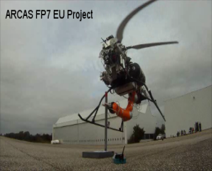
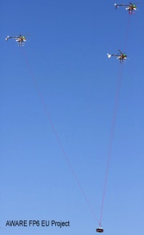
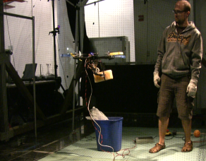
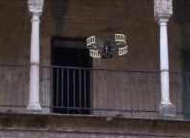
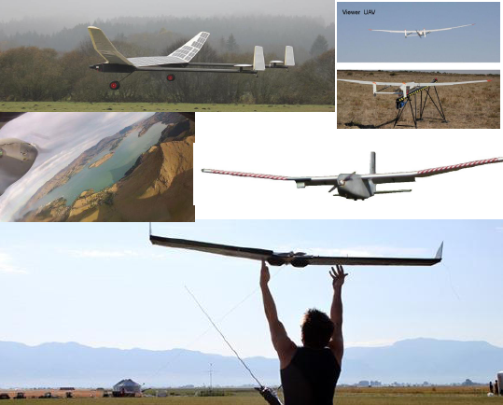
Technical Committee on Aerial Robotics and Unmanned Aerial Systems
Scope. Flying opens new opportunities to robotically perform services and tasks like search and rescue, observation, mapping or even inspection and maintenance. Key areas to be addressed include innovative unmanned aerial vehicles design, autonomous missions, guidance, navigation and control, integration of UAS into national air space, and multi-vehicle coordination.
Topics of Interest Include but not limited to: Airframe design; Field service; Sensor suites; Human-computer interfaces; Autonomous tasks; Localization; Propulsion and Engines; Airworthiness, Aerial vehicle teams; Aerial manipulation.
Major activities include the organization of events such as ICUAS 2013 and RED-UAD 2013, Workshops and summer schools;
TC-Cochairs:
A. Ollero, University Sevilla (Spain), aollero@cartuja.us.es,
YangQuan Chen, Univ. of California, Merced (USA), ychen53@ucmerced.edu
Kimon P Valavanis, University of Denver (USA), kimon.valavanis@du.edu

Slide 27
IEEE RAS TC ARUAV
New TC website:
http://ieee-aerialrobotics-uavs.org/
Official TC link:
http://www.ieee-ras.org/aerial-robotics-and-unmanned-aerial-vehicles/

Slide 28
Round Table Discussions
Moderated by YangQuan Chen
Points for thoughts
What end users need in precision ag?
Crop stress early detection; soil analyzing drones?
Service models?
“Flying tractors”?
Delivery model?
Cloud, smart phone, smart tweeting?

Slide 29
Thank you for attending my talk! For more information, check http://mechatronics.ucmerced.edu/

