Slide 1
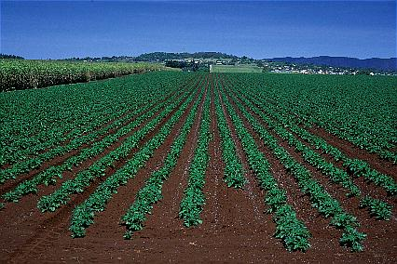
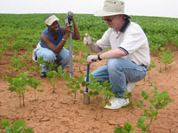
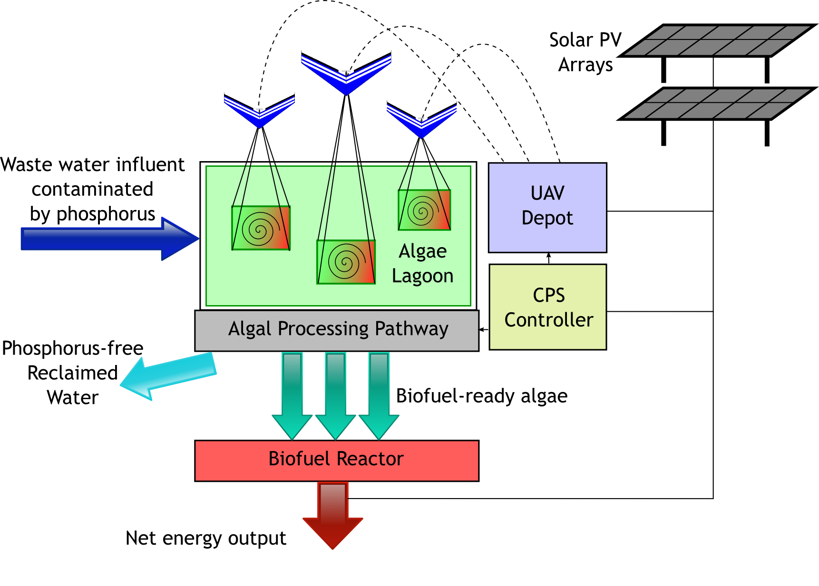
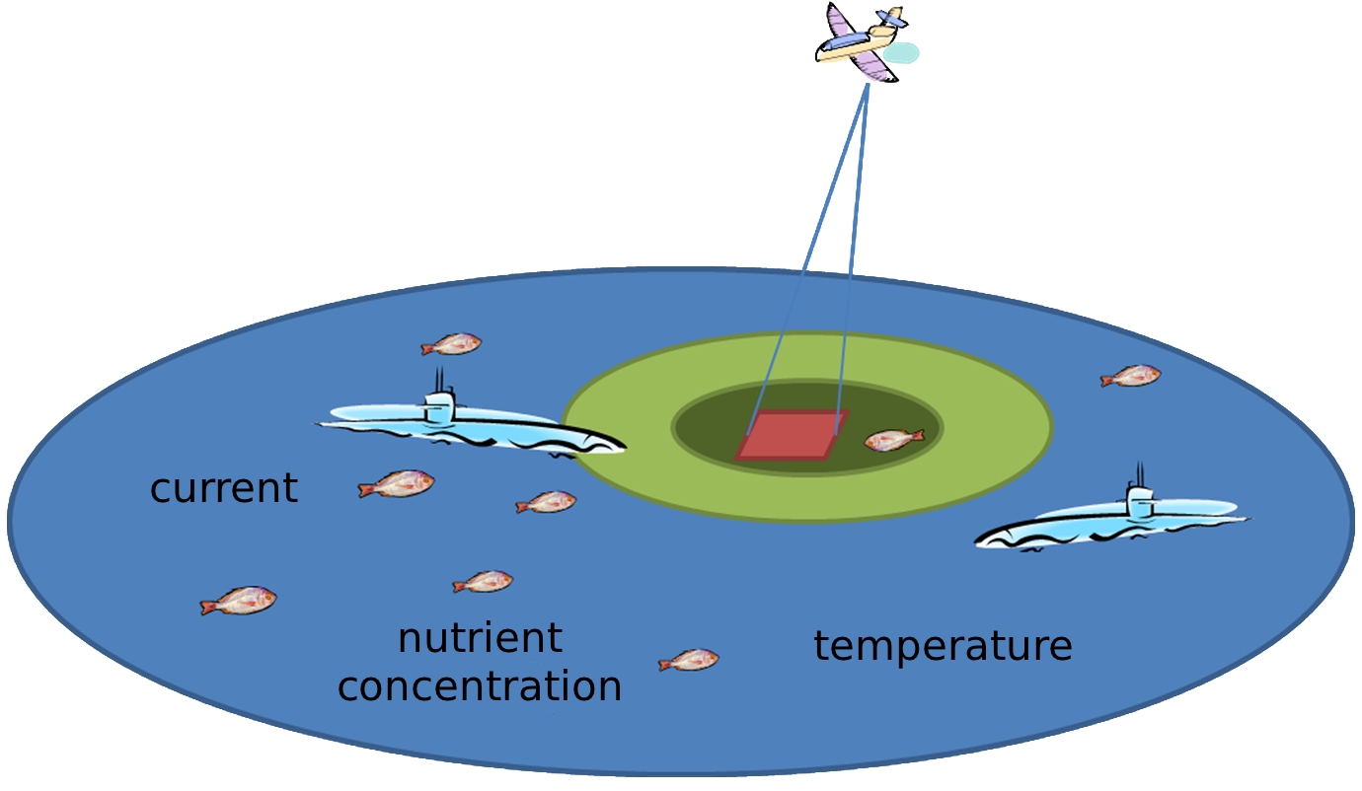
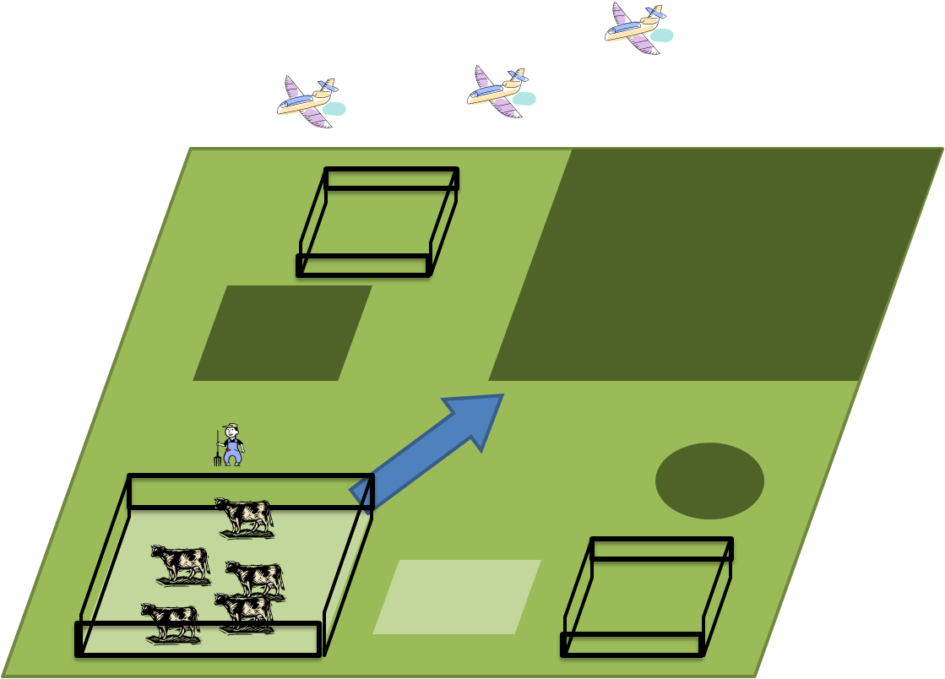
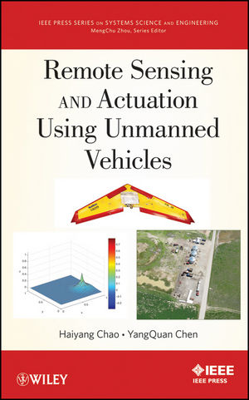
Cyber-Physical Systems
WaterWatch?
Water Resources, Gates, Flumes
Irrigation Control
More Real-time Water Management
At the right time
At the right place
With the right amount
Weather, Climate
Irrigators
Demand
Geo-Domain
UAVs
Water Rights
human
crops
animals
etc.
Ground Sensor Pods
Credit: Dr. YangQuan Chen, 2005
Water Treatment Lagoon
UAS-enabled CPS to create biofuel from waste
UASs provide accurate remote sensing data
Algal Bloom Tracking & Modeling
Agriculture in 2100s
when no more synthetic fertilizers available

