Slide 1
Fractional Order Mechanics: Why, What and WHEN
YangQuan Chen, Ph.D., Director,
MESA (Mechatronics, Embedded Systems and Automation)Lab
MEAM/EECS, School of Engineering,
University of California, Merced
E: yqchen@ieee.org; or, yangquan.chen@ucmerced.edu
T: (209)228-4672; O: SE1-254; Lab: Castle #22 (T: 228-4398)
Oct. 30, 2012. Tuesday 11:00-12:00
Castle Research Facility Room #22

Slide 2
MESA Lab http://mechatronics.ucmerced.edu
Mechatronics, Embedded Systems and Automation
  Backup name: Mechatronics, Energy Systems and Autonomy
  ASME DED, MESA TC. http://iel.ucdavis.edu/mesa/
    2013 MESA conference: Portland, OR http://www.asmeconferences.org/IDETC2013/

Slide 3
MESA Lab Philosophy and Ambition
"We make real systems that work and others want them."
MESA Lab: Staying on top and for sustainability.
Nationally and internationally visible and prominent!

Slide 4
MESA Research Areas/Strengths
Unmanned Aerial Systems and UAV-based Personal Remote Sensing (PRS)
Cyber-Physical Systems (CPS)
Modeling and Control of Renewable Energy Systems
Mechatronics
Applied Fractional Calculus (AFC)

Slide 5
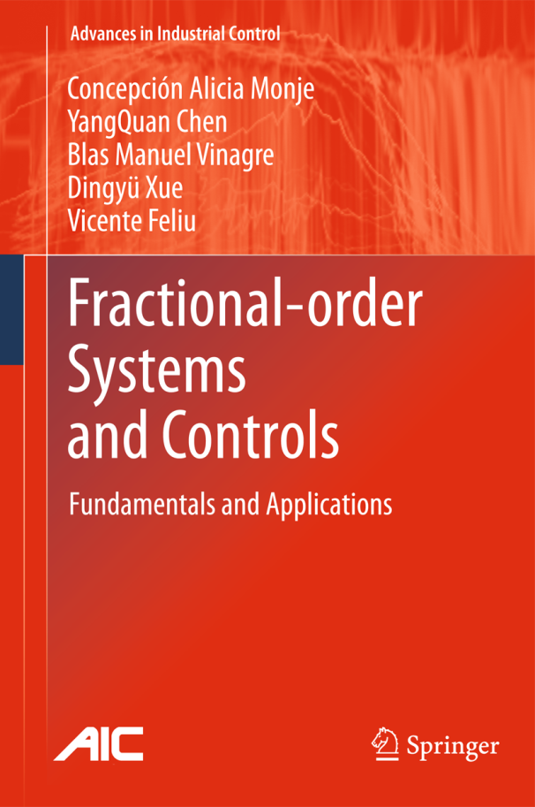
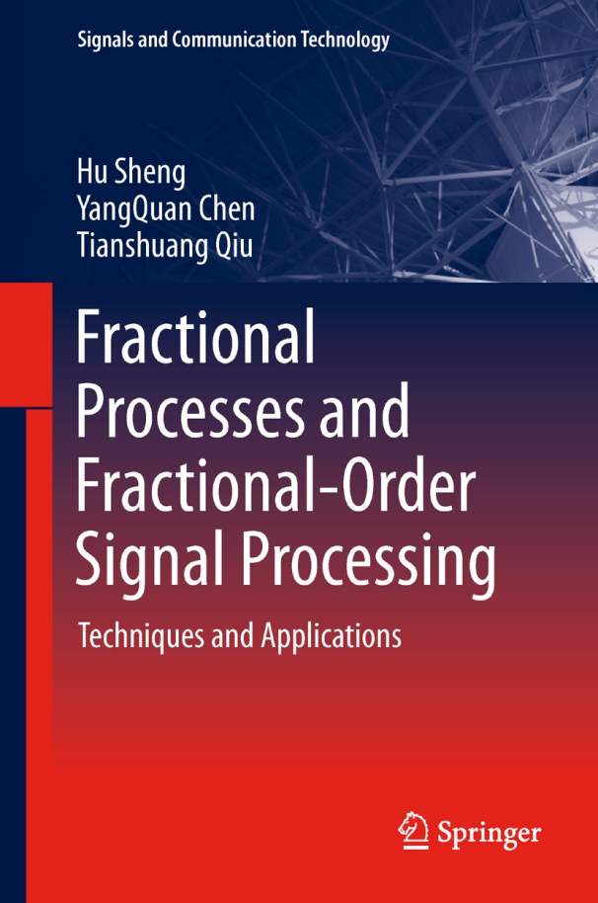
FOMech: WHY?
2001-2010
2005-2011

Slide 6
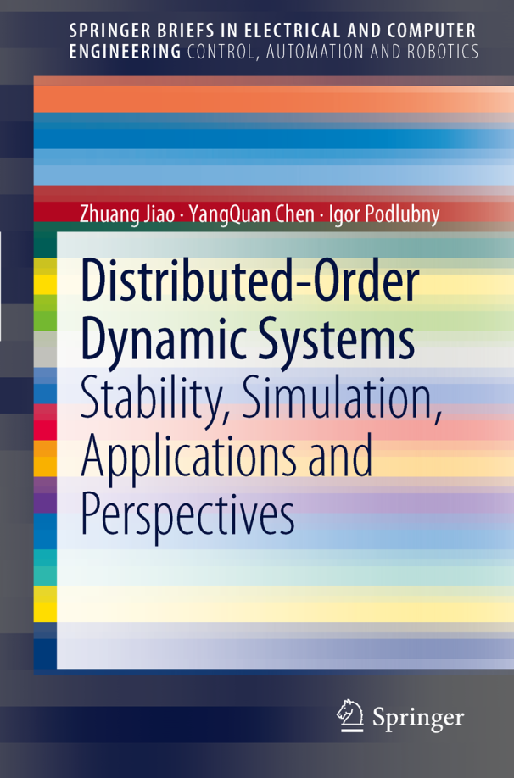
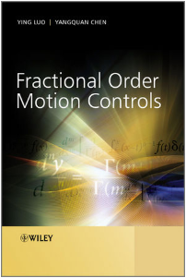
FOMech: WHY?

Slide 7
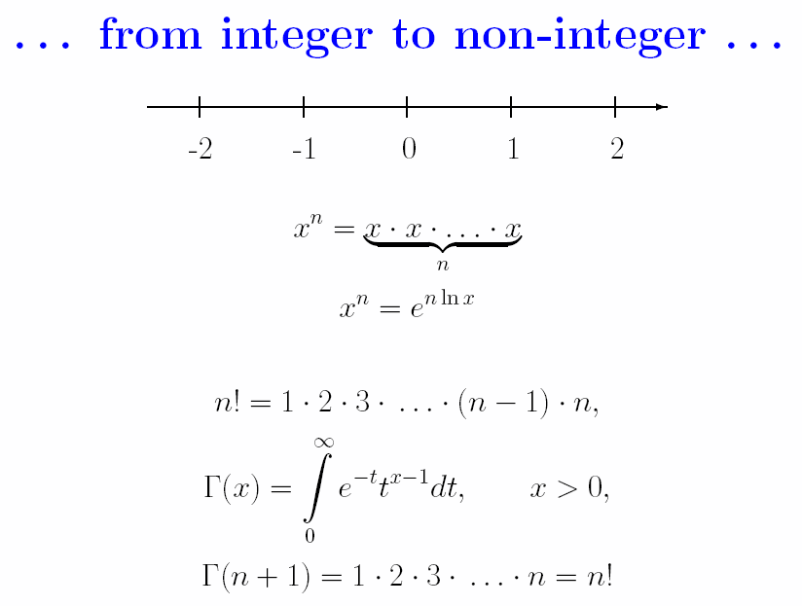
Slide credit: Igor Podlubny

Slide 8
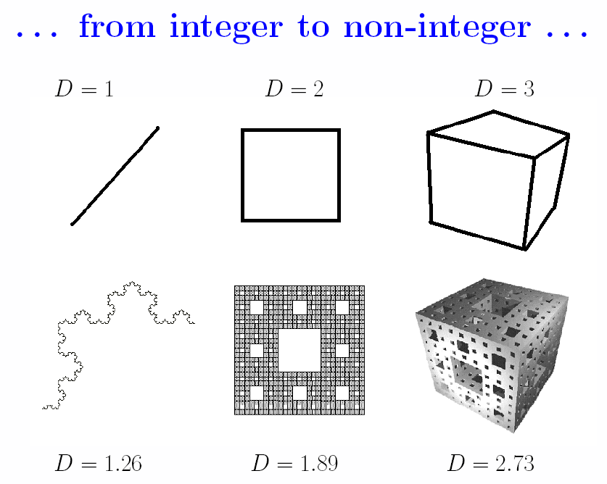
Slide credit: Igor Podlubny

Slide 9
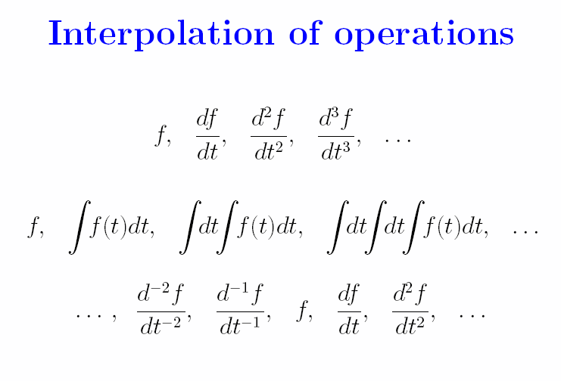
Slide credit: Igor Podlubny

Slide 10
“Fractional Order Thinking” or, “In Between Thinking”
For example
  Between integers there are non-integers;
  Between logic 0 and logic 1, there is the “fuzzy logic”;
  Between integer order splines, there are “fractional order splines”
  Between integer high order moments, there are noninteger order moments (e.g. FLOS)
  Between “integer dimensions”, there are fractal dimensions
  Fractional Fourier transform (FrFT) – in-between time-n-freq.
  Non-Integer order calculus (fractional order calculus – abuse of terminology.) (FOC)

Slide 11

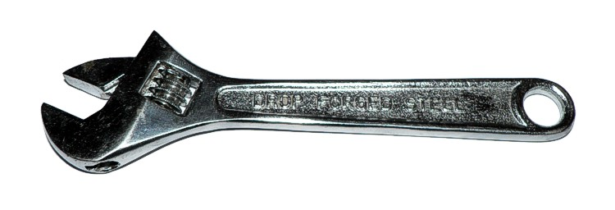
Conclusion of Talk
Integer-Order Calculus
Fractional-Order Calculus
Slide credit: Richard L. Magin, ICCC12
Notes:
11

Slide 12
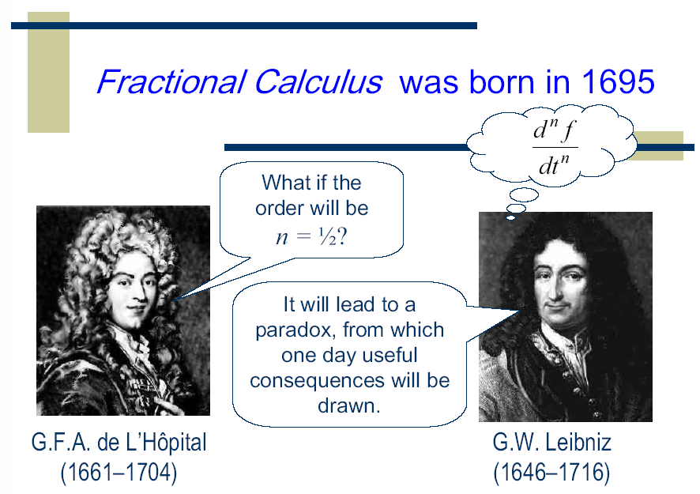
Slide credit: Igor Podlubny

Slide 13
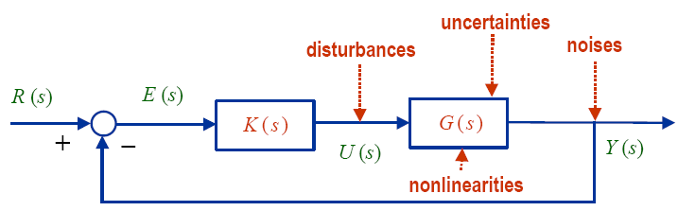
FOMs and Fractional Order Controls
IO Controller + IO Plant
FO Controller + IO Plant
FO Controller + FO Plant
IO Controller + FO Plant
Concepcin A. Monje, YangQuan Chen, Blas Vinagre, Dingyu Xue and Vicente Feliu (2010). “Fractional Order Systems and Controls - Fundamentals and Applications.” Advanced Industrial Control Series, Springer-Verlag, www.springer.com/engineering/book/978-1-84996-334-3 (2010), 415 p. 223 ill.19 in color.

Slide 14
Rule of thumb for
Fractional Order Thinking
Self-similar
Scale-free/Scale-invariant
Power law
Long range dependence (LRD)
1/f ª noise
Porous media
Particulate
Granular
Lossy
Anomaly
Disorder
Soil, tissue, electrodes, bio, nano, network, transport, diffusion, soft matters (biox) …

Slide 15
Fractional Order Mechanics: WHY?
Softmatter / hardmatter
Softbody / Rigidbody
Lumped / distributed
Granular, particulate, porous, disordered … materials
…

Slide 16
Soft matter？
Soft matters, also known as complex fluids, behave unlike ideal solids and fluids.
Mesoscopic macromolecule rather than microscopic elementary particles play a more important role.

Slide 17
Typical soft matters
Granular materials
Colloids, liquid crystals, emulsions, foams,
Polymers, textiles, rubber, glass
Rock layers, sediments, oil, soil, DNA
Multiphase fluids
Biopolymers and biological materials
highly deformable, porous, thermal fluctuations play major role, highly unstable

Slide 18

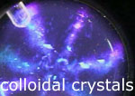



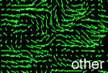





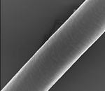

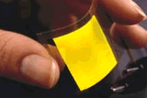
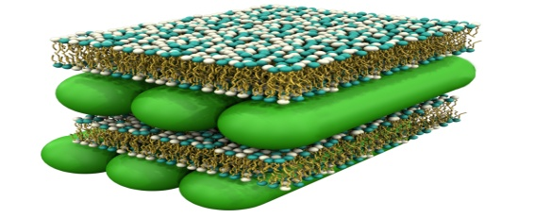
Slide credit: Wen Chen of HHU

Slide 19
Constitutive relationships
Hookian law in ideal solids:
Ideal Newtonian fluids:
Newtonian 2nd law for rigid solids:
One model of soft matter:
Slide credit: Wen Chen of HHU

Slide 20
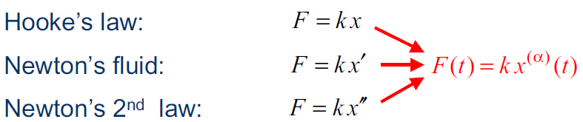

Fractional Order Mechanics!
Going in-between: interpolation of operators:

Slide 21
Kurt Lewin: “There is nothing so practical as good theory" (p. 169).
  Lewin, K. (1951). Field theory in social science. New York: Harper & Row.

Slide 22
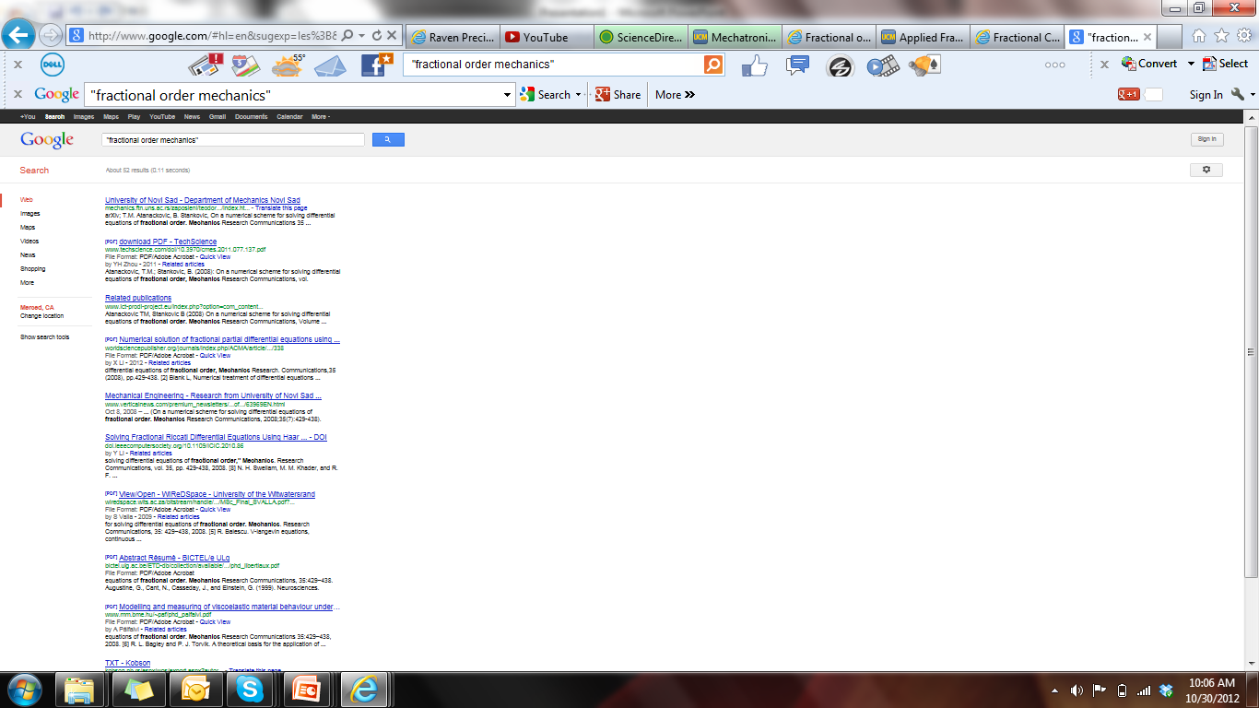
Google says“Fractional Order Mechanics”

Slide 23
G.W. Scott Blair (1950)
“We may express our concepts in Newtonian terms if we find this convenient but, if we do so, we must realize that we have made a translation into a language which is foreign to the system which we are studying.”

Slide 24
Key reference links
CDC10 tutorial: http://mechatronics.ece.usu.edu/foc/cdc10tw/
http://people.tuke.sk/igor.podlubny/USU/
http://mechatronics.ece.usu.edu/foc/afc/
http://www.wydawnictwa.pcz.pl/book/102/introduction-fractional-mechanics
FDA Express: http://em.hhu.edu.cn/fda/
ICFDA2014 http://www.icfda14.dieei.unict.it/committee.html

Slide 25
FOMech:
What should be included in the course?
At UC Merced, ME280 “Fractional Order Mechanics” will be officially offered from Fall 2013 by Prof. YangQuan Chen. (was VOM)
We are defining this course right now with some initial thinking

Slide 26
TOC of ME280 FOMech
FC basics; FC signals and systems
FC modeling (ML fitting) of complex relaxation processes
Bagley-Torvik mechanics
Fractional Euler-Lagrange Equation
Advanced topics (application oriented) (FISP – focused independent study and presentation)
  Battery system models, biological signal processing
  Fractional Order ESC, nanomaterial modeling
  Salinity dynamics, complexity quantification
  Hysteresis modeling and compensation
  FO stochastic mechanics for evolving complex networks etc.

Slide 27
FOMech: WHEN?
Self-similar
Scale-free/Scale-invariant
Power law
Long range dependence (LRD)
1/f ª noise
Porous media
Particulate
Granular
Lossy
Anomaly
Disorder
Soil, tissue, electrodes, bio, nano, network, transport, diffusion, soft matters (biox) …

