Slide 1
Mechatronics Meets Fractional Calculus
YangQuan Chen, Ph.D., Director,
MESA (Mechatronics, Embedded Systems and Automation)Lab
MEAM/EECS, School of Engineering,
University of California, Merced
E: yqchen@ieee.org; or, yangquan.chen@ucmerced.edu
T: (209)228-4672; O: SE1-254; Lab: Castle #22 (T: 228-4398)
Castle Research Facility, UC Merced
June 12, 2013

Slide 2
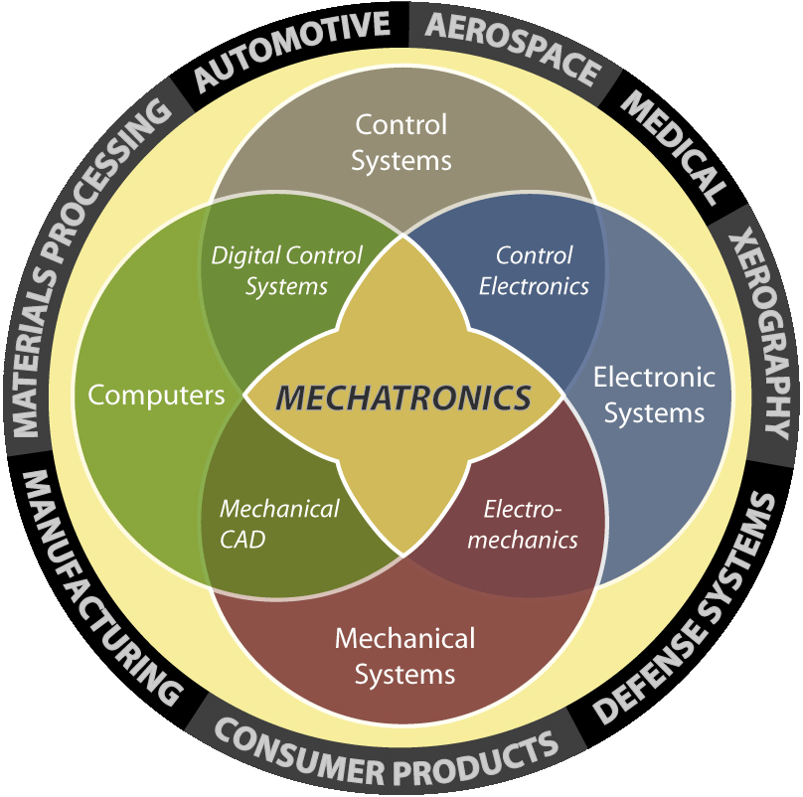
Mechatronics
has good prospects for the future because knowledge economy demands to speed up development, improve quality, reduce cost and increase energy efficiency.
Kevin Craig, Marquette Univ.

Slide 3
“Fractional Calculus”: What and Why?
Differentiation and integration of non-integer orders;
Real power of Laplace operator “s” – such as 1/s^{0.5} , known as “half-order integrator”
Tremendous potential in engineering applications and science discoveries.
Connecting lots of dots when things are “complex” or “anomalous”. See a talk: https://vimeo.com/61141696

Slide 4
MESA Research Areas/Strengths
Unmanned Aerial Systems and UAV-based Personal Remote Sensing (PRS)
Cyber-Physical Systems (CPS)
Modeling and Control of Renewable Energy Systems
Mechatronics
Applied Fractional Calculus (AFC)

Slide 5
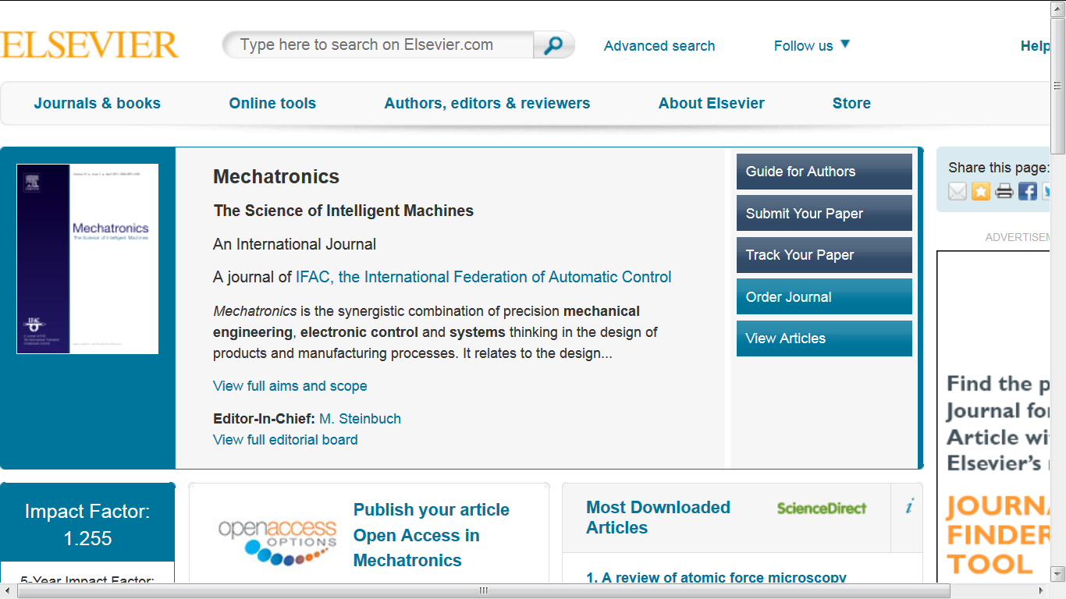

Slide 6
Mechatronics Special Issue Fractional Order Modeling and Control in Mechatronic Applications
Guest Edited by
Dr Clara M. IONESCU of GHENT UNIVERSITY, Belgium,
Prof Dr Ricardo CAPONNETO of University of Catania, ITALY
Prof. YangQuan CHEN of UC Merced, USA
Submissions received: ~30

Slide 7
Purpose of the Special Issue
“The aim of this special issue is to present to the mechatronics research community the usefulness of these tools in a pragmatic context and to stimulate their application. It is in our belief that this special issue will be the milestone of a significant trend in the future of mechatronics. Topics of this special issue include applications of mechanics, electronics, computing, control engineering, molecular engineering (from nanochemistry and biology), and optical engineering, which, combined, make possible the generation of simpler, more economical, reliable and versatile systems.”

Slide 8
Online published papers
Auto-tuning of PID controller according to fractional-order reference model approximation for DC rotor control Baris Baykant Alagoz, Abdullah Ates, Celaleddin Yeroglu
Creep modeling and identification for piezoelectric actuators based on fractional-order system Yanfang Liu, Jinjun Shan, Naiming Qi

Slide 9
Online published papers
Efficient control of a SmartWheel via Internet with compensation of variable delays Inés Tejado, S. Hassan HosseinNia, Blas M. Vinagre, YangQuan Chen
Development and implementation of an FPGA based fractional order controller for a DC motor Cristina I. Muresan, Silviu Folea, George Mois, Eva H. Dulf

Slide 10
Online published papers
Fractional order modeling and control for permanent magnet synchronous motor velocity servo system Wei Yu, Ying Luo, YouGuo Pi
Fractional-order reset control: Application to a servomotor
S. Hassan HosseinNia, Inés Tejado, Blas M. Vinagre

Slide 11
Online published papers
Fractional order control to the electro-hydraulic system in insulator fatigue test device Jiangbo Zhao, Junzheng Wang, Shoukun Wang
Fractional order modelling of dynamic backlash J.A. Tenreiro Machado

Slide 12
Online published papers
Complete synchronization of commensurate fractional order chaotic systems using sliding mode control Abolhassan Razminia, Dumitru Baleanu
Identification and tuning fractional order proportional integral controllers for time delayed systems with a fractional pole Hadi Malek, Ying Luo, YangQuan Chen

Slide 13
Online published papers
Control of a novel chaotic fractional order system using a state feedback technique Abolhassan Razminia, Delfim F.M. Torres
On the general Kalman filter for discrete time stochastic fractional systems Hoda Sadeghian, Hassan Salarieh, Aria Alasty, Ali Meghdari

Slide 14
Online published papers
Disturbance Observer Design with Bode's Ideal Cut-Off Filter in Hard-Disc-Drive Servo System.
Ying Luo, Tao Zhang, BongJin Lee, Changik Kang, YangQuan Chen

Slide 15
Future Perspectives
Biomechatronics
Nanomechatronics
Optomechatronics
Human-centric Mechatronics

Slide 16
ASME IDETC/CIE, Portland, OR, USA
August 4-8, 2013
ASME/IEEE MESA2013 Panel Session on
“Mechatronics meets fractional calculus: A status update and the future directions”
http://www.asmeconferences.org/idetc2013/

Slide 17
Panelists
Om Agrawal, Univ. of Southern Illinois, Carbondale, USA
Dumitru Baleanu, Çankaya University, Ankara, Turkey
YangQuan Chen (Moderator). University of California, Merced, USA
Tom Hartley, University Of Akron, USA
Malgorzata Klimek, Czestochowa University of Technology, Czestochowa, Poland
Changpin Li, Shanghai University, China
Jiaguo Liu, Shandong University, Weihai, China
J. A. Tenreiro Machado, Institute of Engineering of the Polytechnic Institute of Porto, Portugal

Slide 18
More Optimal Image Processing by Fractional Order Differentiation and Fractional Order Partial Differential Equations
International Symposium on Fractional PDEs: Theory, Numerics and Applications, June 3-5, 2013, Salve Regina University, 100 Ochre Point Avenue, Newport RI 02840
Dali Chen, Dingyu Xue, YangQuan Chen
xuedingyu@ise.neu.edu.cn,
chendali@ise.neu.edu.cn
Information Science and Engineering
Northeastern University
Shenyang 110004, P R China
yqchen@ieee.org, ychen53@ucmerced.edu
ME/EECS/SNRI/UCSolar
MESA LAB, School of Engineering,
University of California, Merced, USA

Slide 19
Take home message:
More optimal image processing can be made possible by using fractional order differentiation and fractional order partial differential equations.
Want to be more optimal? Go fractional calculus!
Q & A
More info:
http://mechatronics.ucmerced.edu/research/applied-fractional-calculus

Slide 20
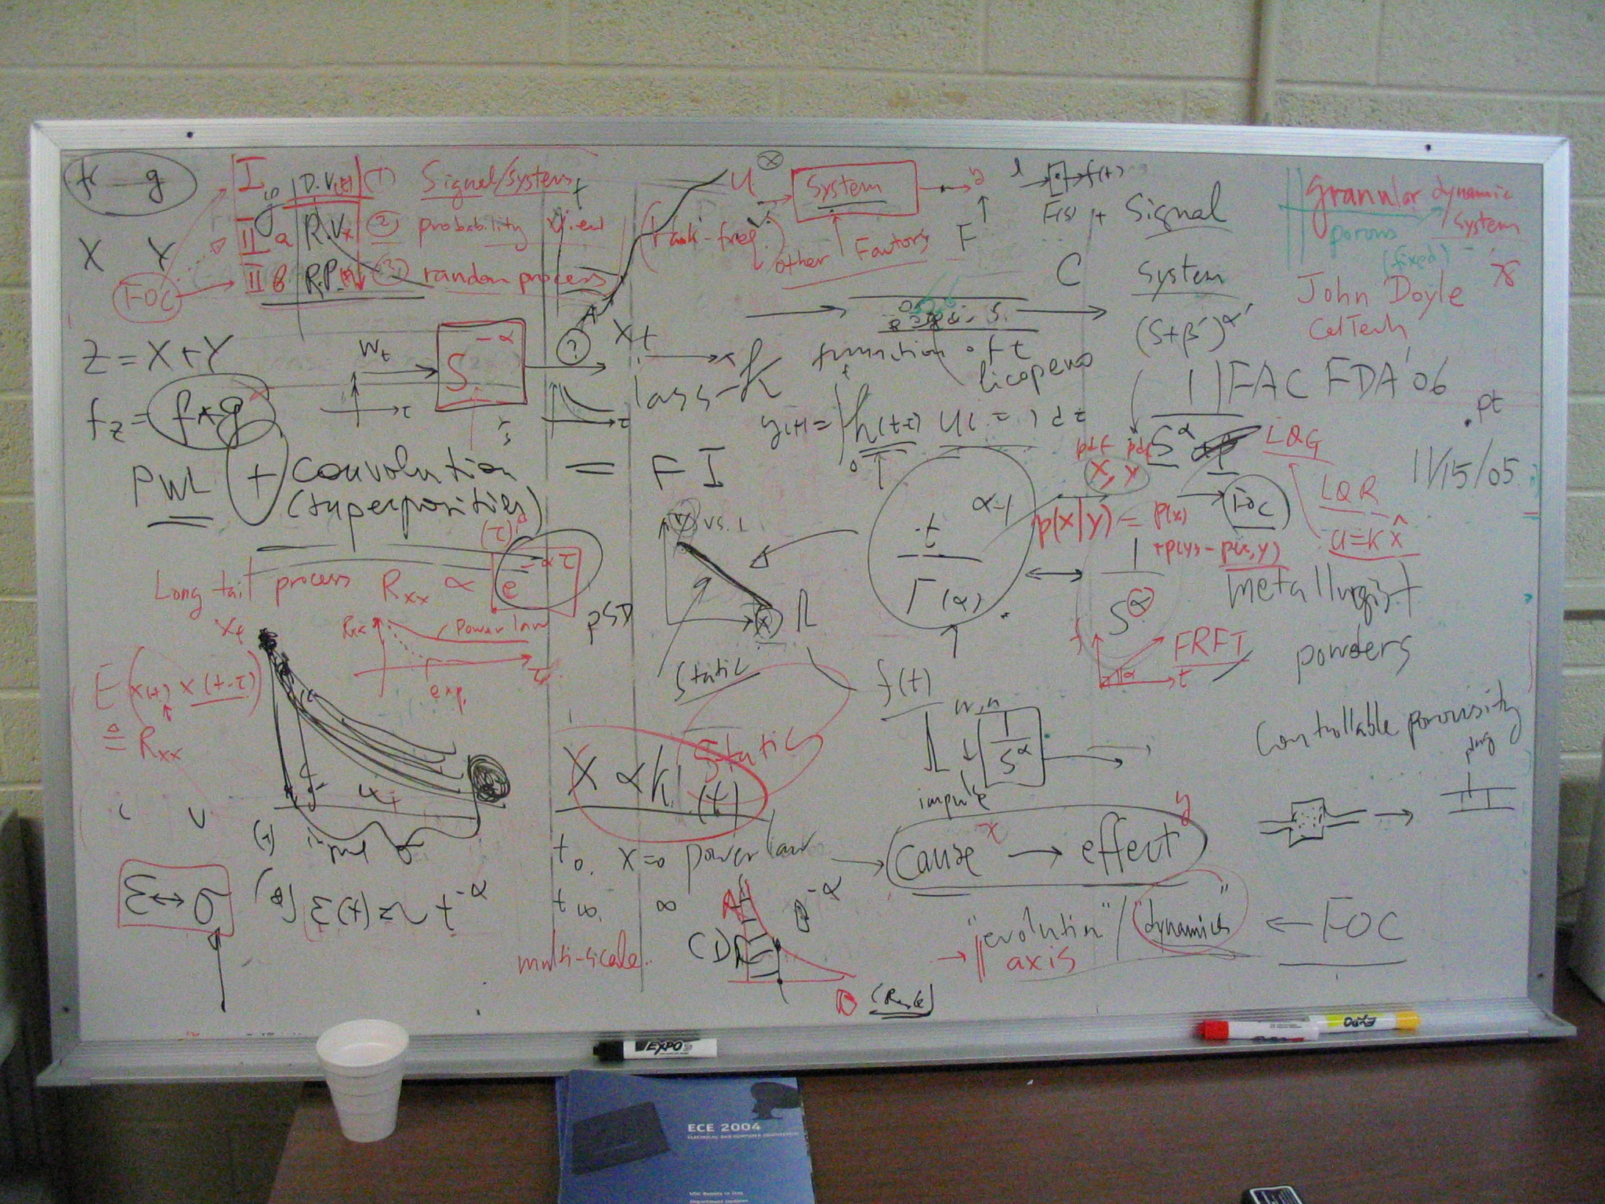
A snap shot of discussion board of Igor Podlubny and YangQuan Chen in Sept. 2005

