Slide 1
Fractional Order Motion Controls: How Motion/Process Control Can Benefit from using Fractional Calculus?

Slide 2
A Tutorial on Fractional Order Motion Control

Slide 3
A Tutorial on Fractional Order Motion Control
Part I: Overview of the Book and
Fundamentals of Fractional Order Controls

Slide 4
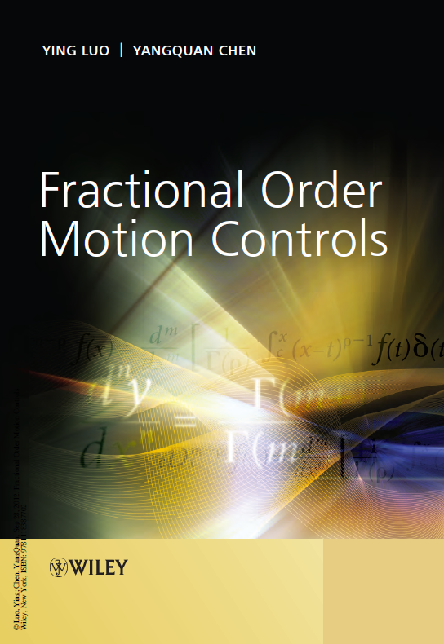
Overview of the book
Fractional Order Motion Controls
John Wiley & Sons, Inc.
Hardcover, 454 pages, December 2012
Dr. Ying Luo
Automation Science and Engineering, South China University of Technology, Guangzhou, PR China
Dr. YangQuan Chen
Director, Mechatronics, Embedded Systems and Automation (MESA) LAB
MEAM/EECS, School of Engineering,
University of California, Merced
Email: yqchen@ieee.org
Notes:
This tutorial is generally based on this book. As the title implies, this book is a monograph on fractional order motion controls.

Slide 5
Scope of the book
PART I FUNDAMENTALS OF FRACTIONAL CONTROLS
1 Introduction 3
PART II FRACTIONAL ORDER VELOCITY SERVO
2 Fractional Order PI Controller Designs for Velocity Servo Systems 25
3 Tuning Fractional Order PI Controllers for Fractional Order Velocity Systems with Experimental Validation 41
4 Relay Feedback Tuning of Robust PID Controllers 59
5 Auto-Tuning of Fractional Order Controllers with ISO-Damping 73
PART III FRACTIONAL ORDER POSITION SERVO
6 Fractional Order PD Controller Tuning for Position Systems 91
7 Fractional Order [PD] Controller Synthesis for Position Servo Systems 105
8 Time-Constant Robust Analysis and Design of Fractional Order [PD] Controller 123
9 Experimental Study of Fractional Order PD Controller Synthesis for Fractional Order Position Servo Systems 139
10 Fractional Order [PD] Controller Design and Comparison for Fractional Order Position Servo Systems 155
PART IV STABILITY AND FEASIBILITY FOR FOPID DESIGN
11 Stability and Design Feasibility of Robust PID Controllers for FOPTD Systems 165
12 Stability and Design Feasibility of Robust FOPI Controllers for FOPTD Systems 187
PART V FRACTIONAL ORDER DISTURBANCE COMPENSATORS
13 Fractional Order Disturbance Observer 211
14 Fractional Order Adaptive Feed-forward Cancellation 223
15 Fractional Order Robust Control for Cogging Effect 243
16 Fractional Order Periodic Adaptive Learning Compensation 275
PART VI EFFECTS OF FRACTIONAL ORDER CONTROLS ON NONLINEARITIES
17 Fractional Order PID Control of A DC-Motor with Elastic Shaft 293
18 Fractional Order Ultra Low-Speed Position Servo 313
19 Optimized Fractional Order Conditional Integrator 329
PART VII FRACTIONAL ORDER CONTROL APPLICATIONS
20 Lateral Directional Fractional Order Control of A Small Fixed-Wing UAV 345
21 Fractional Order PD Controller Synthesis and Implementation for HDD Servo System 369
Notes:
The table of contents is listed here to show what one can expect from this book.

Slide 6
Contribution of this monograph
In the velocity and position motion systems, fractional calculus is applied to the FO modeling and FO controllers design in systematic ways to achieve better performances than the designed integer order controllers using traditional optimization methods. Stability and feasibility issues are analyzed and discussed for the fractional order controllers design.
FO disturbance observer, FO adaptive feed-forward scheme, FO adaptive control and FO periodic adaptive learning control for external disturbance compensation are presented.
This book documents the very first optimization approach of the proposed FO conditional integrator for nonlinear system controls. Meanwhile, some efforts of the fractional order control on nonlinearities, for example, friction and backlash, are presented.
Simulation illustrations and/or experimental validations are demonstrated for all the proposed control schemes and approaches. The real applications for FO motion controls on unmanned aerial vehicles and hard-disk drives are presented in this book.
Contributions

Slide 7
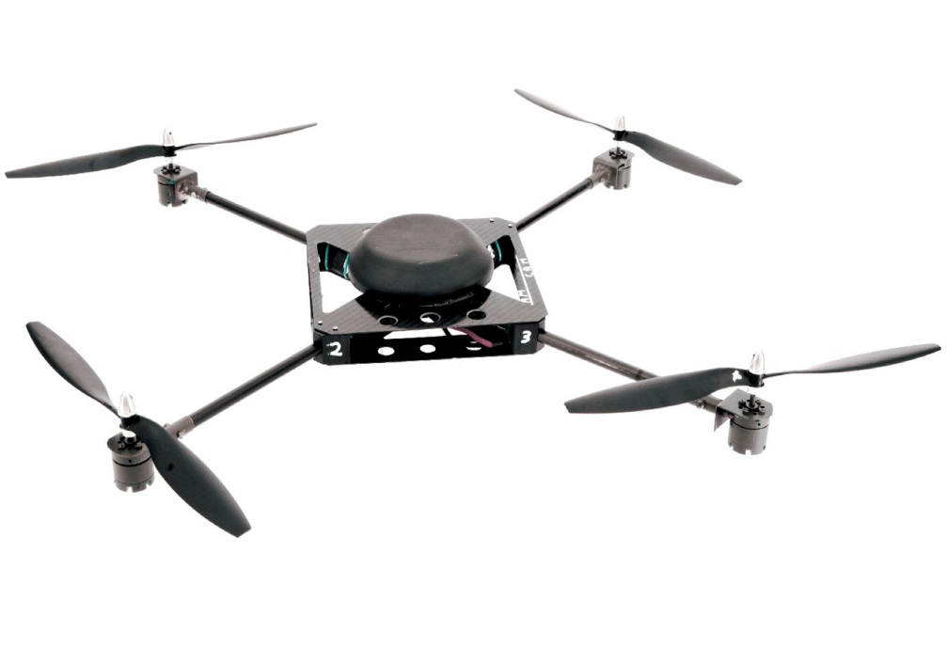
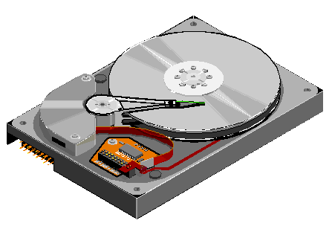
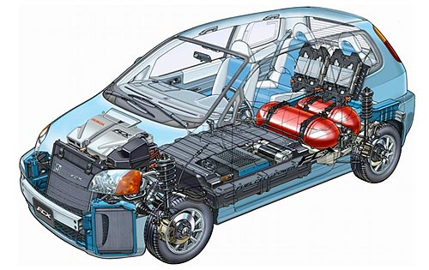
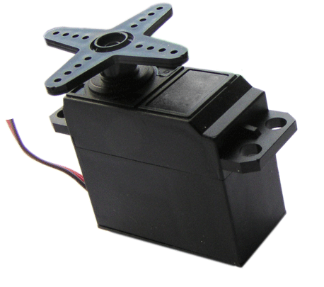
Applications
Picture from http://www.cguru.info/automobile.htm
Notes:
The application of motion control are so board that it can be found wherever there are servers or engines involved.

Slide 8
Introduction to controls
Collection of resources for control tutorial
Control Tutorials for MATLAB and Simulink
http://ctms.engin.umich.edu/CTMS/index.php?aux=Home
Notes:
This slide is prepared for readers who need review of some concepts in classic controls and modern controls

Slide 9
Fundamentals of fractional calculus
Collection of resources for fractional calculus
Fractional Calculus Day @ UCMerced
http://mechatronics.ucmerced.edu/node/68
Applied Fractional Calculus (AFC) @ UCMerced
http://mechatronics.ucmerced.edu/research/applied-fractional-calculus
Applied Fractional Calculus (AFC) @ USU
http://mechatronics.ece.usu.edu/foc/
Notes:
If you are doing research on fractional order calculus and controls, this is a event you must not miss !!

Slide 10
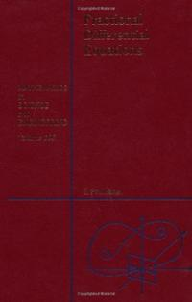
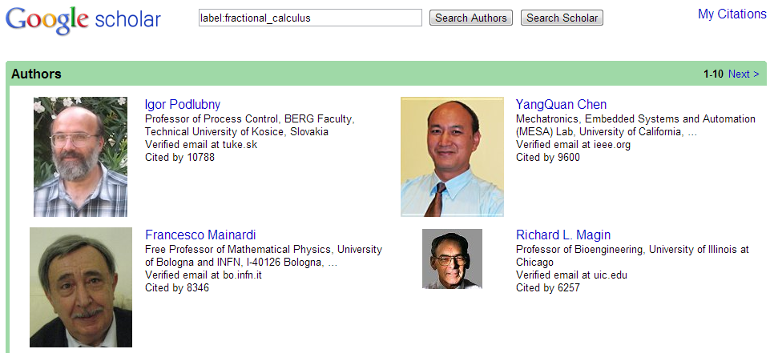
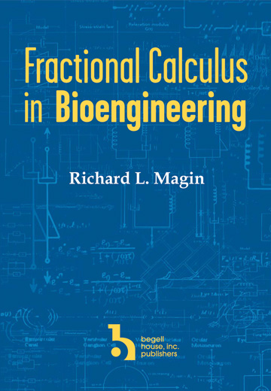
Fundamentals of fractional calculus
Collection of resources for fractional calculus
Richard Magin, Fractional Calculus in Bioengineering, ISBN: 978-1-56700-215-7, 684 pages, 2006.
Igor Podlubny, Fractional Differential Equations, 1st Edition, An Introduction to Fractional Derivatives, Fractional Differential Equations, to Methods of Their Solution and Some of Their Applications, 1998

Slide 11
Fundamentals of fractional calculus
Crises in the foundations of mathematics push the development of math
Paradox
What does n=1/2 mean in the derivative of a function?
Figure: The born of fractional calculus

Slide 12
Fundamentals of fractional calculus
Definition 1
Fractional Order Cauchy integral formula
where C is the closed-path that encircles the poles of the function f (t).
Definition 2
Grünwald-Letnikov definition
where $\left(\begin{matrix}α \\ j\end{matrix}\right)$ are the binomial coefficients; the subscripts to the left and right of D are the lower- and upper-bounds in the integral. The value $α$ can be positive or negative, corresponding to differentiation and integration, respectively.

Slide 13
Fundamentals of fractional calculus
Definition 3
Riemann-Liouville definition
where $0<α<1$, and a is the initial value. Let a = 0, the notation of integral can be simplified to${{ D}_{t}^{}}^{−α}f(t)$.
Definition 4
Caputo definition
where $α= m + γ$, m is an integer and $0<γ≤1$.

Slide 14
Fundamentals of fractional calculus
Fractional order differential equations
Laplace transform of a fractional order derivative operator
$$D^{α}→s^{α}$$
Where $−1≤α≤n$.
(6)
Laplace transform of the above differential equation

Slide 15
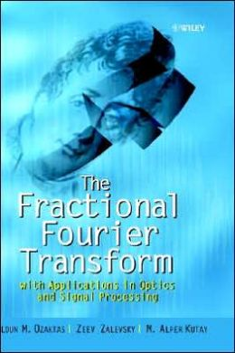
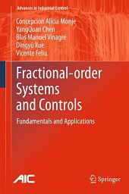
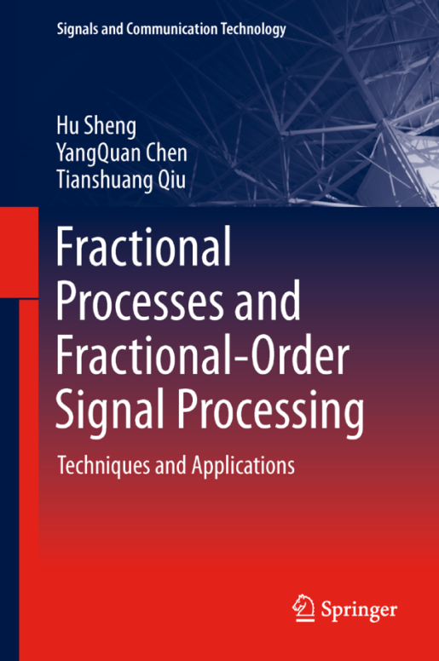
Fundamentals of fractional calculus
Fourier transform of a fractional order derivative/integral operator
where $α$ can be either positive or negative real number.
Notes:
For more information on fractional Fourier transforms, refer to

Slide 16
Fundamentals of fractional calculus
The advantages of fractional order models
They depict the real world objects more accurately;
Variable stability region;
etc...
G.W. Scott Blair (1950)
“We may express our concepts in Newtonian terms if we find this convenient but, if we do so, we must realize that we have made a translation into a language which is foreign to the system which we are studying.”

Slide 17
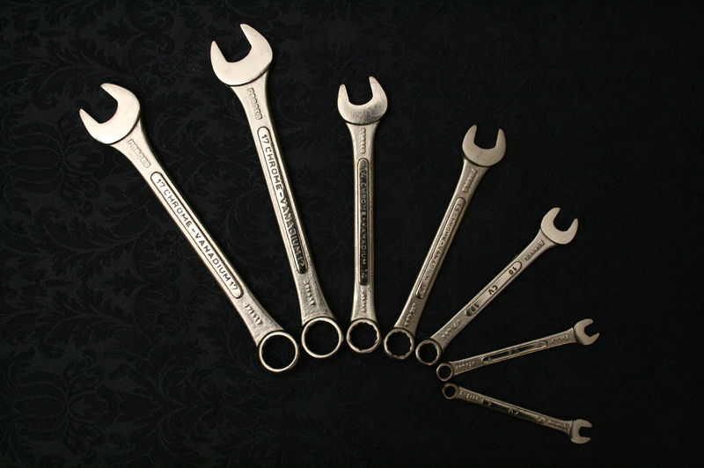
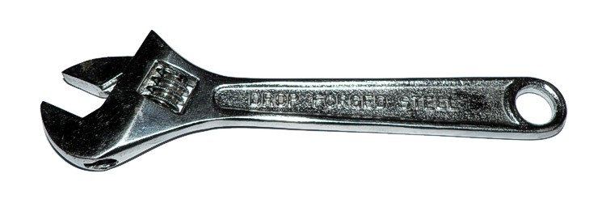
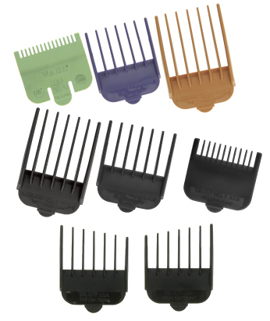
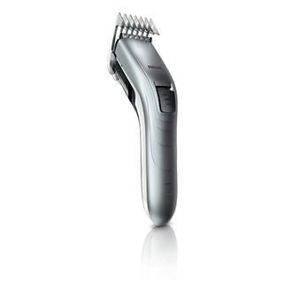
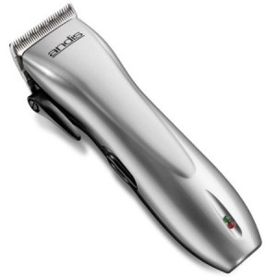
The power of fractional calculus
Fractional-Order Calculus
Integer-Order Calculus
Dr. Richard L. Magin, ICCC12
Zhuo LI 2013

Slide 18
Fundamentals of fractional calculus
Why many integer order models depict real world objects well enough?
The “fractance” of many objects are usually very low.
Why integer order models are more popular?
Complexity of solutions to FO differential equations;
Ignorance of the existence of fractional order models.
Notes:
Now you may have the following questions

Slide 19
Introduction to Fractional Order Controls
Collection of resources for fractional order control
Fractional Order Controls: A beginner’s view
http://mechatronics.ucmerced.edu/sites/mechatronics.ucmerced.edu/files/page/documents/afc-csois-zhuo-2012-5-14.pdf
Chen, Y.; Petras, I.; Xue, D, "Fractional order control - A tutorial" American Control Conference. ACC '09, pp.1397,1411, Jun 10-12, 2009
Podlubny, I, “Fractional-Order Systems and $PI^{λ}D^{μ}$Controllers”, IEEE Transactions on Automatic Control, Vol. 44, No. 1, January 1999
Oustaloup, Alan, etc, The CRONE Team, “From Fractal Robustness to the CRONE Approach”, ESAIM: Proc., 1998, Vol. 5, pp. 177-192
Notes:
Get a jump start with fractional order control

Slide 20
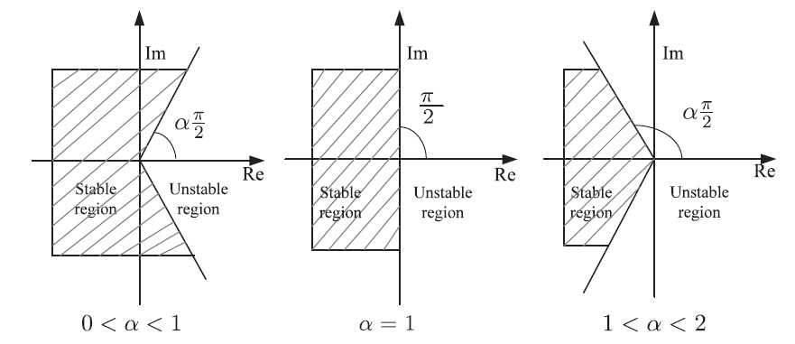
Fundamentals of fractional order controls
Stability of LTI Fractional Order Systems
Figure: Stability region of LTI fractional order systems

Slide 21
Fundamentals of fractional order controls
Four combinations
IO model, IO controller
IO model, FO controller
FO model, IO controller
FO model, FO controller
Notes:
Three of the four combinations will be covered in this tutorial

Slide 22
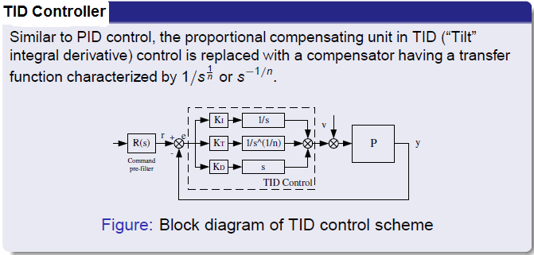
TID Controller

Slide 23
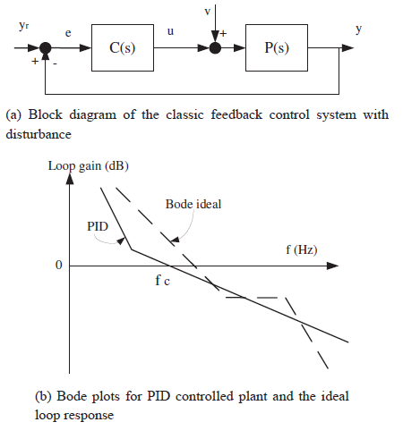
TID Controller
Motivation of the TID controller
Figure: Bode plots for PID controlled plant and the ideal loop response

Slide 24
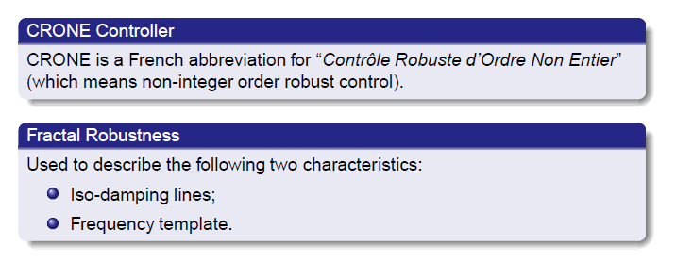
CRONE controller

Slide 25
$PI^{λ}D^{μ}$Controller

Slide 26
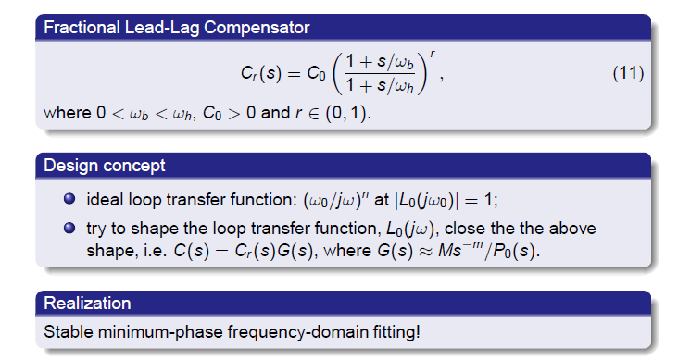
FO Lead-lag compensator

Slide 27
The end of session I
This is the end of session I
Questions?

