Slide 1

Scaling Laws in Cognitive Science
Christopher Kello
Cognitive and Information Sciences
Thanks to NSF, DARPA,
and the Keck Foundation

Slide 2

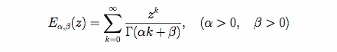
Background and Disclaimer
Cognitive Mechanics…
Fractional Order Mechanics?

Slide 3
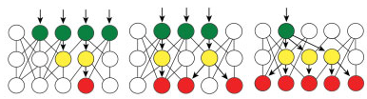
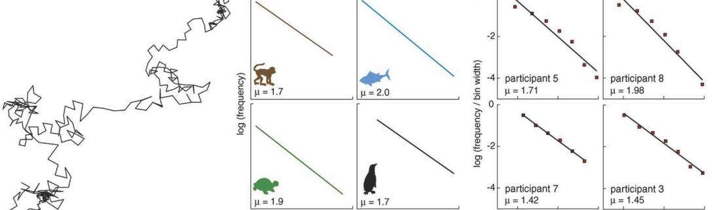

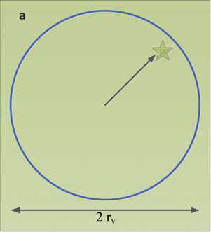
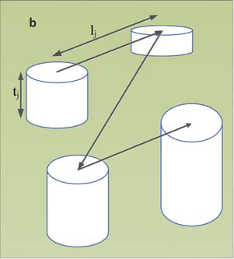

Reasons for FC in Cogsci
Intrinsic Fluctuations
Critical Branching
Lévy-like Foraging
Continuous-Time
Random Walks

Slide 4
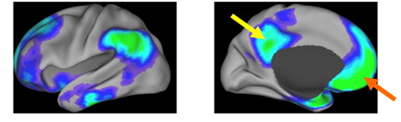
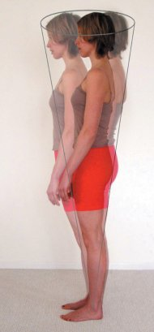
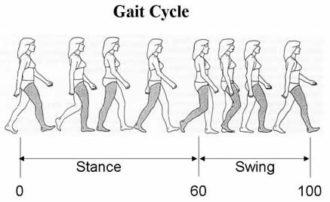
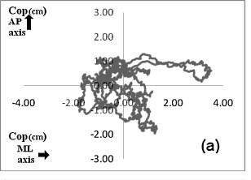
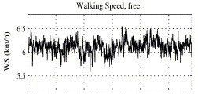
Intrinsic Fluctuations
Neural activity is intrinsic and ever-present
  Sleep, “wakeful rest”
Behavioral activity also has intrinsic expressions
  Postural sway, gait, any repetition

Slide 5
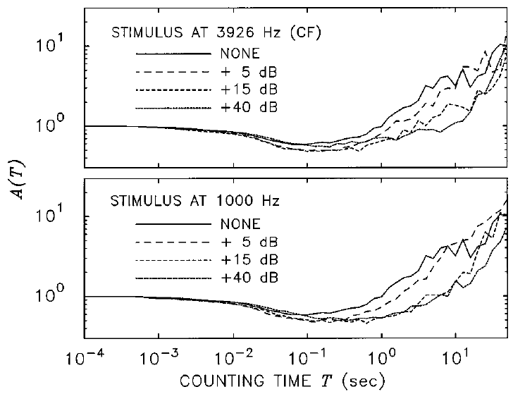
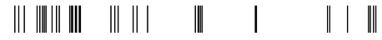
Intrinsic Fluctuations In Spike Trains
Allan Factor Analyses Show Scaling Law Clustering
Lowen & Teich (1996), JASA

Slide 6
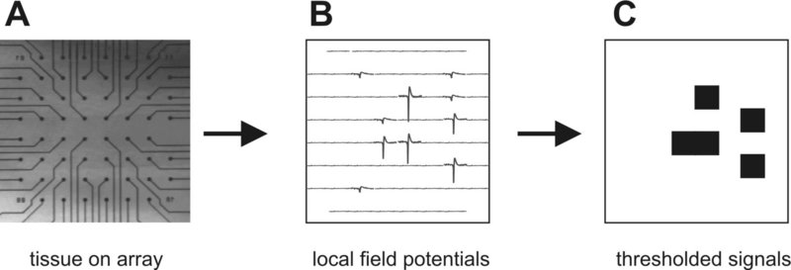

Intrinsic Fluctuations in LFPs
Bursts of LFP Activity in
Rat Somatosensory Slice Preparations
Beggs & Plenz (2003), J Neuroscience

Slide 7
Intrinsic Fluctuations in LFPs
Burst Sizes Follow a 3/2 Inverse Scaling Law
Intact Leech Ganglia Dissociated Rat Hippocampus
Mazzoni et al. (2007), PLoS One

Slide 8
Intrinsic Fluctuations in Speech

Slide 9
Intrinsic Fluctuations in Speech

Slide 10
Intrinsic Fluctuations in Speech
Log S(f)
Log f
S(f) ~ 1/f^{α}

Slide 11
Scaling Laws in Brain and Behavior
How can we model and simulate the pervasiveness of these scaling laws?
  Clustering in spike trains
  Burst distributions in local field potentials
  Fluctuations in repeated measures of behavior

Slide 12
Critical Branching
Critical branching is a critical point between damped and runaway spike propagation
pre
post
Damped Runaway

Slide 13
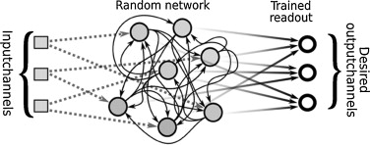
Spiking Network Model
Leaky
Integrate
&
Fire
Neuron
Source
Sink
Reservoir

Slide 14
Critical Branching Algorithm

Slide 15
Critical Branching Tuning
Tuning ON Tuning OFF

Slide 16
Spike Trains

Slide 17
Allan Factor Results

Slide 18
Neuronal Bursts

Slide 19
Neuronal Avalanche Results

Slide 20
Simple Response Series

Slide 21
1/f Noise in Simple Responses

Slide 22
Memory Capacity of Spike Dynamics

Slide 23
Critical Branching and FC
The critical branching algorithm produces pervasive scaling laws in its activity.
FC might serve to:
  Analyze and better understand the algorithm
  Formalize the capacity for spike computation
  Refine and optimize the algorithm

Slide 24







Lévy-like Foraging
$$P\left(l\right)\sim l^{−μ}$$
$$1<μ<3$$
$$P\left(t_{i}\right)\sim {\left(t_{i}+1\right)}^{−μ}$$
$$P\left(t_{i}\right)\sim {\left(t_{i}+1\right)}^{−μ}$$
$$μ \sim 2$$
$$μ \sim 2$$
Animal Foraging
Memory Foraging

Slide 25
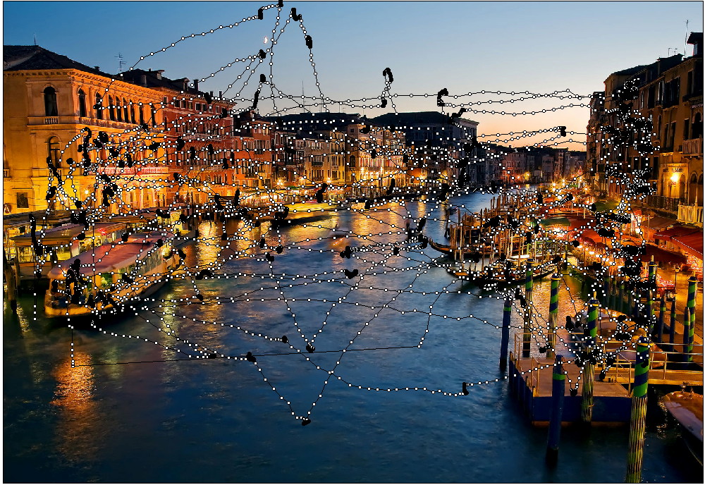
Lévy-like Visual Search

Slide 26
Lévy-like Visual Search

Slide 27
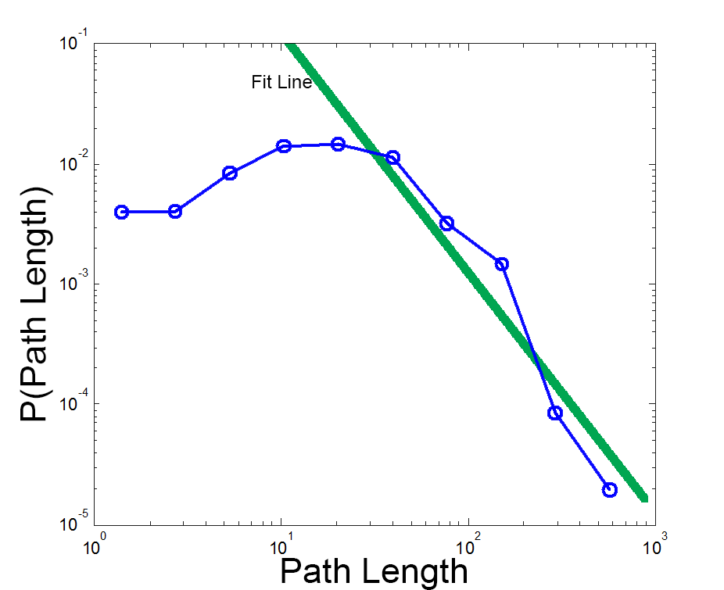
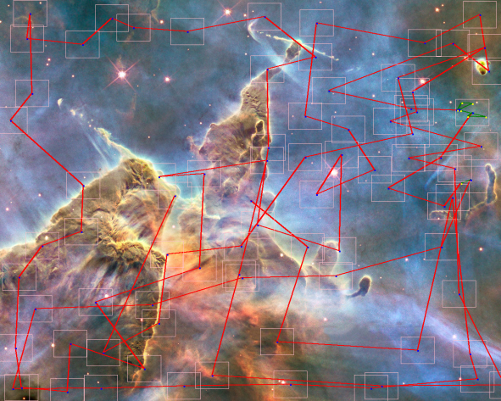
Lévy-like Foraging Games

Slide 28
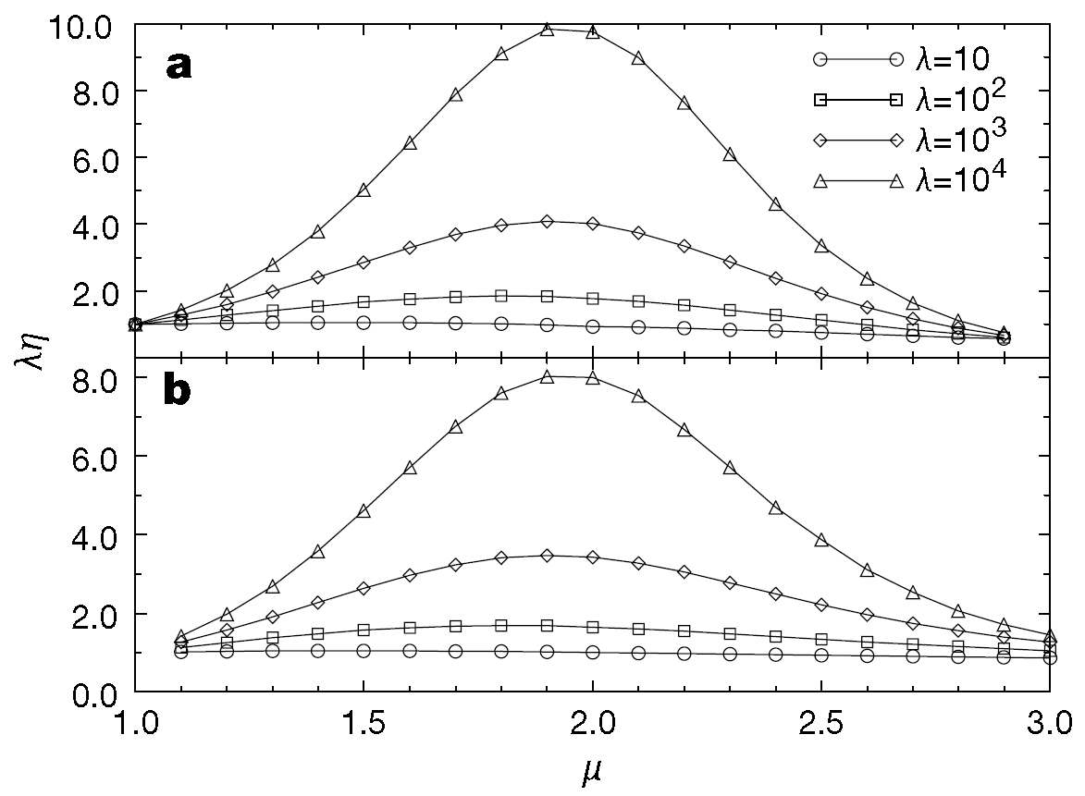
“Optimizing” Search with Levy Walks
Lévy walks with μ ~ 2 are maximally efficient under certain assumptions
How can these results be generalized and applied to more challenging search problems?

Slide 29




Continuous-Time Random Walks
In general, the CTRW probability density obeys
Mean waiting time:
Jump length variance:
Notes:
Continuous time random walk

Slide 30
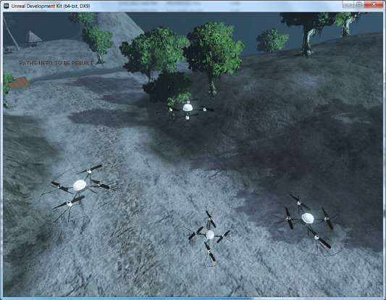
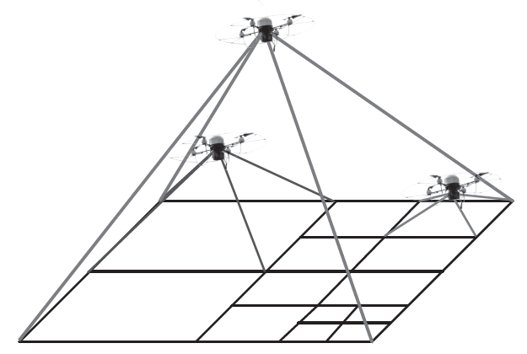
Human-Robot Search Teams
Human-controlled and algorithm-controlled search agents in virtual environments
Wait times correspond to times for vertical movements
Tradeoff between sensor
accuracy and scope
Notes:
Continuous time random walk

Slide 31
Conclusions
Neural and behavioral activities generally exhibit scaling laws
Fractional calculus is a mathematics suited to scaling law phenomena
Therefore, cognitive mechanics may be usefully formalized as fractional order mechanics

Slide 32
Collaborators
Gregory Anderson
Brandon Beltz
Bryan Kerster
Jeff Rodny
Janelle Szary
Marty Mayberry
Theo Rhodes
John Beggs
Stefano Carpin
YangQuan Chen
Jay Holden
Guy Van Orden

