Slide 1
Study on a fractional model of viscoelasticity of human cranial bone
Jiaguo Liu, Mingyu Xu
School of Mathematics,
Shandong University,
Jinan, 250100, P.R. China.

Slide 2
1. Introduction
Bone is anisotropic and viscoelastic
Study on mechanical behavior of Cranial bone is the basic work of research on craniocerebral injury.
The researches on dynamic behavior of bones are important in guiding orthopaedics diseases, cure of bone injure, substitutive materials and healing study.

Slide 3
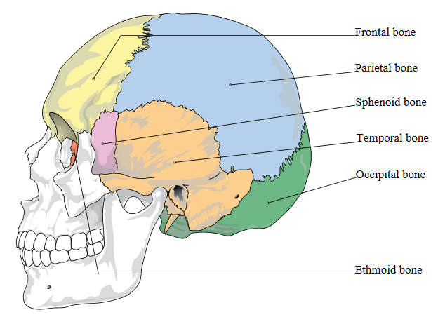
Cranial Bones: eight bones

Slide 4
Zhu et al’ study on the behavior of cranial bone by classical St.Venant model
Classical Maxwell and Zener model’s fractional order generalizations

Slide 5
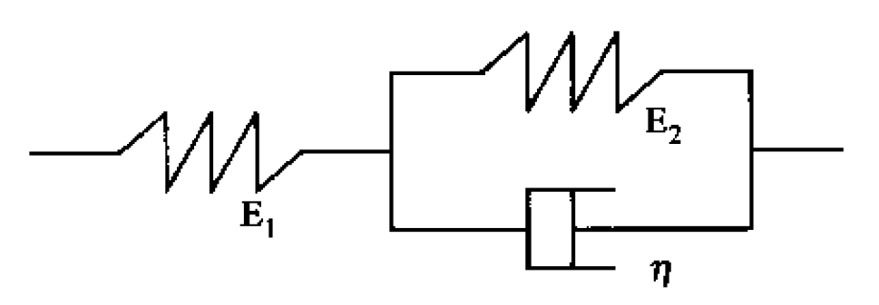
2. Fractional generalization of classical St.Venant model
2.1 The classical (integer order) St.Venant model is shown as follows
Its constitutive equation is
(1)

Slide 6
where and denote the stress and strain, is the elastic coefficients, and is the viscosity.
(2)
Obviously,
(3)

Slide 7
2.2 Fractional generalization of St.Venant model
Riemann-Liouville fractional operators:
(4)
(5)

Slide 8
Let
, (6)
. (7)
is equivalent with Eq. (1).
Integrals from to give
, (8)
, (9)
where and are initial values of and respectively.

Slide 9
Substituting by in (8), and
by in (9), we obtain
results the fractional St.Venant model:
(10)

Slide 10
3. Solutions of fractional St.Venant model
3.1 Relaxation and creep function of fractional St.Venant model
Laplace transform of (10) gives
. (11)
Let , where is the Heaviside unit step function, from (11) we obtain
(12)

Slide 11
The discrete inverse Laplace transform of (12) give the relaxation modulus of fractional St.Venant model
, (13)
where is the H-Fox function.

Slide 12
The deduction uses the following properties of the H-Fox function:
(14)
where is also called Maitland’s generalized hypergeometric function.
(15)

Slide 13
In a similar way, the creep compliance of fractional St.Venant model can be obtained
(16)
where

Slide 14
When , (13) and (16) reduce to the relaxation modulus and creep compliance of classical (integer order) St.Venant model
(17)
(18)

Slide 15
3.2 The fractional relaxation and creep functions under quasi-static loading
The loading processes of relaxation and creep tests are, respectively,
(19)
(20)
where and are constant strain and stress rates, respectively, and and are constants.

Slide 16
By Boltzmann superposition principle
from (13) and (16) we obtain the relaxation and creep response functions

Slide 17
(21)

Slide 18
(22)

Slide 19
When , the relaxation and creep functions of classical St.Venant model are
(23)
(24)

Slide 20
4. Data fitting and comparison
The relaxation and creep functions (21) and (22) are fitted with the experimental data from Zhu et al’s, and we take parameters A, B, E₁，E₂，t₁ , τ_{r}, τ_{d} the same values as Zhu et al’s.

Slide 21
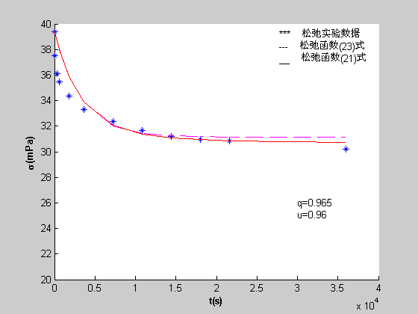
(***): Relaxation experimental data from [5]; (---): the relaxation function (23) of the standard St.Venant model; (—):the relaxation function (21) of the fractional St.Venant model. Here, q=0.965, μ=0.96.

Slide 22
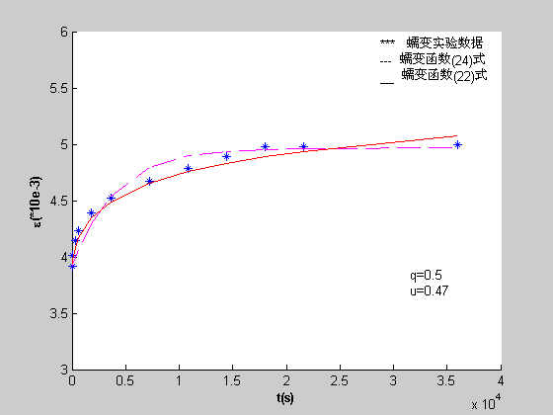
(***): Creep experimental data from [5]; (---): the creep function (24) of the standard St.Venant model; (—):the creep function (22) of the fractional St.Venant model. Here, q=0.5, μ=0.47.

Slide 23
It is shown that, the fractional St.Venant model is more efficient than the standard St.Venant model with integer order in describing the stress-strain constitutive relations for the viscoelasticity of human cranial bone.

Slide 24
5. Conclusion
The fractional St.Venant model is more efficient than the classical model in describing the stress-strain constitutive relations for the viscoelasticity of human cranial bone.
It is efficient that applying fractional calculus method to describe constitutive relations of biological viscoelastic materials.

Slide 25
Thank you very much!
Jiaguo Liu
liujiaguo@sdu.edu.cn

